Slide 1
An Introduction to Hill Ciphers
Using Linear Algebra

Slide 2
Hill Ciphers
Created by Lester S. Hill in 1929
Polygraphic Substitution Cipher
Uses Linear Algebra to Encrypt and Decrypt

Slide 3
Polygraphic Substitution Ciphers
Encrypts letters in groups
Frequency analysis more difficult

Slide 4
Hill Ciphers
Polygraphic substitution cipher
Uses matrices to encrypt and decrypt
Uses modular arithmetic (Mod 26)

Slide 5
Modular Arithmetic
For a Mod b, divide a by b and take the remainder.
14 ÷ 10 = 4
14 Mod 10 = 4
24 Mod 10 = 4

Slide 6



Modulus Examples

Slide 7
Modular Inverses
Inverse of 2 is ½ (2 · ½ = 1)
Matrix Inverse: AA⁻¹= I
Modular Inverse for Mod m: (a · a⁻¹) Mod m = 1
For Modular Inverses, a and m must NOT have any prime factors in common

Slide 8
Modular Inverses of Mod 26
A | 1 | 3 | 5 | 7 | 9 | 11 | 15 | 17 | 19 | 21 | 23 | 25
A⁻¹ | 1 | 9 | 21 | 15 | 3 | 19 | 7 | 23 | 11 | 5 | 17 | 25
Example – Find the Modular Inverse of 9 for Mod 26
9 · 3 = 27
27 Mod 26 = 1
3 is the Modular Inverse of 9 Mod 26

Slide 9
Hill Cipher Matrices
One matrix to encrypt, one to decrypt
Must be n x n, invertible matrices
Decryption matrix must be modular inverse of encryption matrix in Mod 26

Slide 10
Modularly Inverse Matrices
Calculate determinant of first matrix A, det A
Make sure that det A has a modular inverse for Mod 26
Calculate the adjugate of A, adj A
Multiply adj A by modular inverse of det A
Calculate Mod 26 of the result to get B
Use A to encrypt, B to decrypt

Slide 11



Modular Reciprocal Example

Slide 12
Encryption
Assign each letter in alphabet a number between 0 and 25
Change message into 2 x 1 letter vectors
Change each vector into 2 x 1 numeric vectors
Multiply each numeric vector by encryption matrix
Convert product vectors to letters

Slide 13
Letter to Number Substitution
A | B | C | D | E | F | G | H | I | J | K | L | M
0 | 1 | 2 | 3 | 4 | 5 | 6 | 7 | 8 | 9 | 10 | 11 | 12
N | O | P | Q | R | S | T | U | V | W | X | Y | Z
13 | 14 | 15 | 16 | 17 | 18 | 19 | 20 | 21 | 22 | 23 | 24 | 25

Slide 14

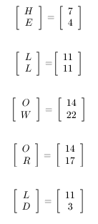
Change Message to Vectors
Message to encrypt = HELLO WORLD

Slide 15
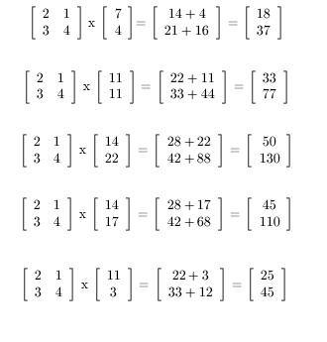
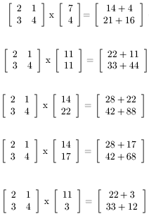
Multiply Matrix by Vectors

Slide 16
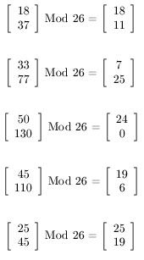
Convert to Mod 26

Slide 17
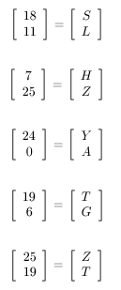
Convert Numbers to Letters
HELLO WORLD has been encrypted to
SLHZY ATGZT

Slide 18
Decryption
Change message into 2 x 1 letter vectors
Change each vector into 2 x 1 numeric vectors
Multiply each numeric vector by decryption matrix
Convert new vectors to letters

Slide 19
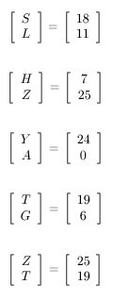

Change Message to Vectors
Message to encrypt = SLHZYATGZT

Slide 20
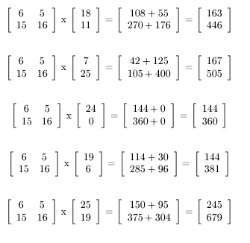
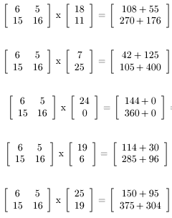
Multiply Matrix by Vectors

Slide 21
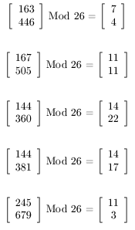
Convert to Mod 26

Slide 22
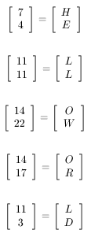
Convert Numbers to Letters
SLHZYATGZT has been decrypted to
HELLO WORLD

Slide 23
Security of Hill Cipher
Secure against Ciphertext Only attack
but easily broken with Known Plaintext attack
For an m x m Hill cipher,
if we know m plaintext-ciphertext pairs,
we can get key matrix K
we know that C_{j} = P_{j} K for 1 ≤ j ≤ m
form two m x m matrices X = (p_{ij}) & Y = (c_{ij})
then we can form matrix eqn Y = X K
if X is invertible, then K = X⁻¹ Y

Slide 24
Security of Hill Cipher
Suppose plaintext “hillcipher” is encrypted with a 2x2 Hill cipher to yield ciphertext HCRZSSXNSP
Thus we know that... (C = PK mod 26)
(7 8) K mod 26 = (7 2)
(11 11) K mod 26 = (17 25)
Using first two plaintext-ciphertext pairs... (Y = XK mod 26)
7 2 = 7 8 K mod 26
17 25 11 11
Find inverse of X to determine K = X⁻¹ Y
K = 25 22 7 2 mod 26 = 3 2
1 23 17 25 8 5
Verify correctness of K...

Slide 25
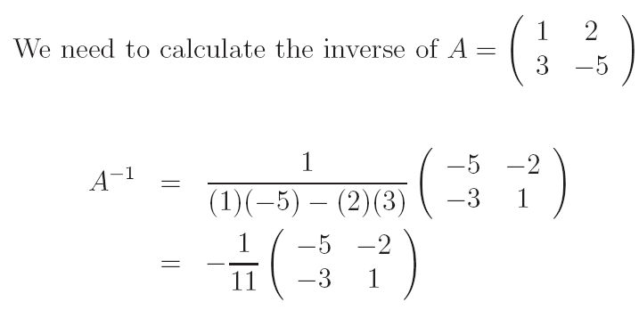
Matrix Inversion (2x2 matrix)
A matrix in invertible if its determinant is non-zero

Slide 26
Conclusion
Creating valid encryption/decryption matrices is the most difficult part of Hill Ciphers.
Otherwise, Hill Ciphers use simple linear algebra and modular arithmetic

Slide 27
Encryption/Decryption using RC4

Slide 28
Types of Encryption
Private/Symmetric Key Cryptography :
Same key is used for encryption and decryption.
Public/Asymmetric Key Cryptography :
Different keys are used for encryption and decryption.

Slide 29
RC4 Basics
A symmetric key encryption algo. Invented by Ron Rivest.
Normally uses 64 bit and 128 bit key sizes.
Most popular implementation is in WEP for 802.11 wireless networks and in SSL.
Cryptographically very strong yet very easy to implement.
Consists of 2 parts: Key Scheduling Algorithm (KSA) & Pseudo-Random Generation Algorithm

Slide 30

RC4 Block Diagram
Secret Key
RC4
Keystream
Plain Text
+
Encrypted
Text

Slide 31
RC4 …break up
Initialize an array of 256 bytes.
Run the KSA on them
Run the PRGA on the KSA output to generate keystream.
XOR the data with the keystream.

Slide 32
Array Initialization
C Code:
char S[256];
Int i;
For(i=0; i< 256; i++)
S[i] = i;
After this the array would like this :
S[] = { 0,1,2,3, ……, 254, 255}
T[i]=K[I mod keylen]
T is temporary array made with secret key.

Slide 33
The KSA
The initialized array S[256] is now run through the KSA. The KSA uses the secret key to scramble the array.
C Code for KSA:
int i, j = 0;
for(i=0; i<256; i++)
{
j = ( j + S[i] + key[ i % key_len] ) % 256;
swap(S[i], S[j]);
}

Slide 34
The PRGA
The KSA scrambled S[256] array is used to generate the PRGA. This is the actual keystream.
C Code:
i = j = 0;
while(output_bytes)
{
i = ( I + 1) % 256;
j = ( j + S[i] ) % 256;
swap( S[i], S[j] );
output = S[ ( S[i] + S[j] ) % 256 ]
}

Slide 35
Encryption using RC4
Choose a secret key
Run the KSA and PRGA using the key to generate a keystream.
XOR keystream with the data to generated encrypted stream.
Transmit Encrypted stream.

Slide 36
Decryption using RC4
Use the same secret key as during the encryption phase.
Generate keystream by running the KSA and PRGA.
XOR keystream with the encrypted text to generate the plain text.
Logic is simple :
(A xor B) xor B = A
A = Plain Text or Data
B = KeyStream

Slide 37
Making of a RC4 File Encryptor
Using a secret key generate the RC4 keystream using the KSA and PRGA.
Read the file and xor each byte of the file with the corresponding keystream byte.
Write this encrypted output to a file.
Transmit file over an insecure channel.

Slide 38
Making of a RC4 File Decryptor
Using the same secret key used to encrypt generate the RC4 keystream.
Read the encrypted file and Xor every byte of this encrypted stream with the corresponding byte of the keystream.
This will yield the original plaintext

Slide 39
Summary
Hill Cipher Encryption/decryption
Cryptanalysis of Hill Cipher
RC4

